Slide 1
計算物理
Hw4: fourth-order Runge Kutta

Slide 2
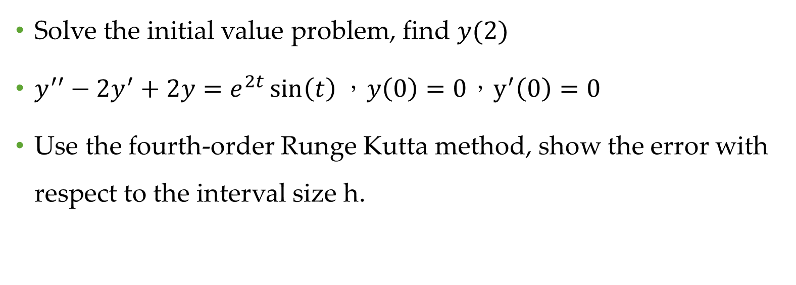
Problem
Solve the initial value problem, find $y(2)$
$y^{′′}−2y^{′}+2y=e^{2t}\sin\left(t\right)，y\left(0\right)=0，y^{′}\left(0\right)=0$
Use the fourth-order Runge Kutta method, show the error with respect to the interval size h.

Slide 3
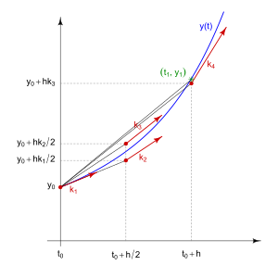
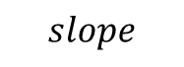
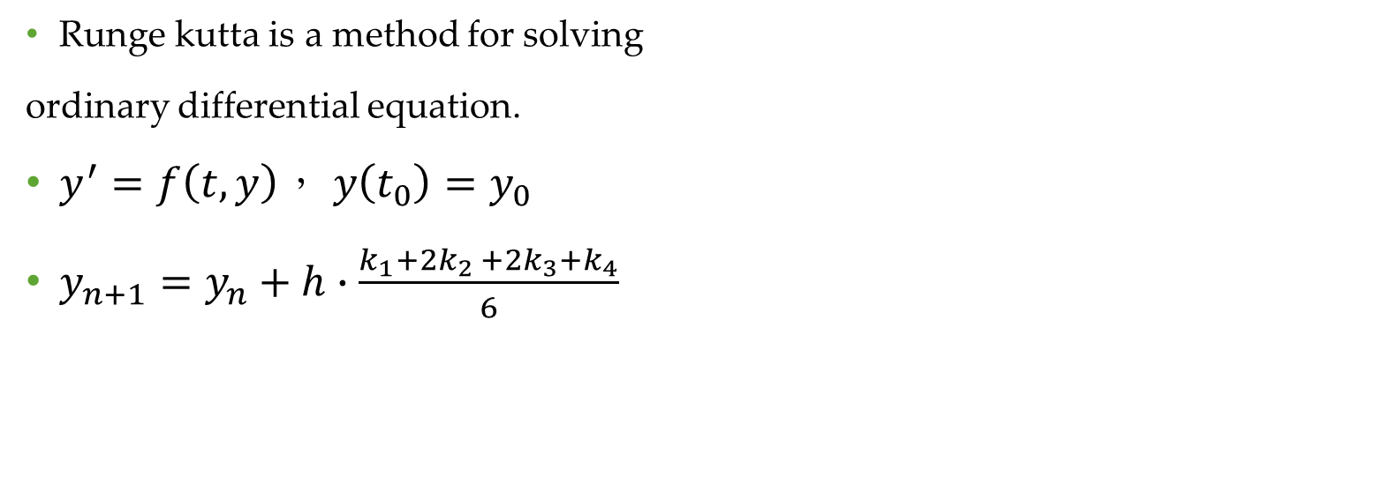
Runge kutta?
Runge kutta is a method for solving
ordinary differential equation.
$y^{′}=f\left(t,y\right)， y\left(t_{0}\right)=y_{0}$
$y_{n+1}=y_{n}+h∙\frac{k_{1}+2k_{2 }+2k_{3}+k_{4}}{6}$
$$slope$$

Slide 4

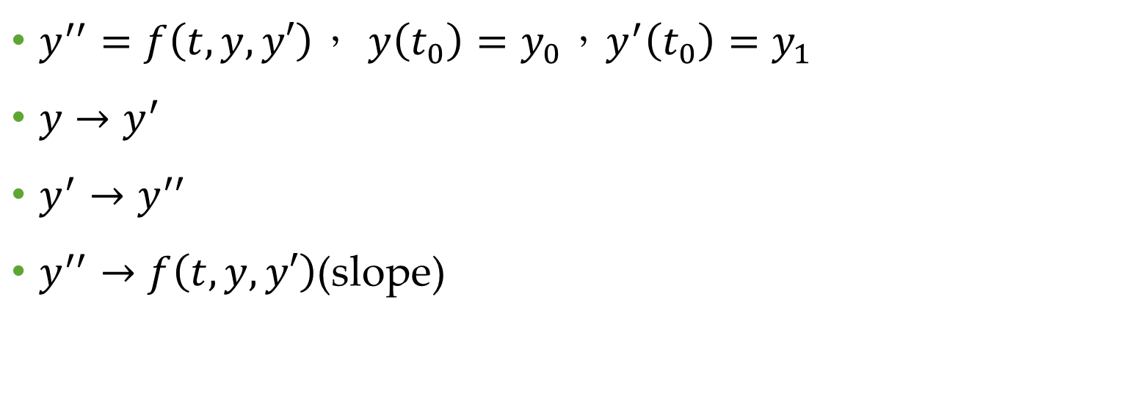
Extend
$$y^{′′}=f\left(t,y,y′\right)$$
$y^{′′}=f\left(t,y,y′\right)$， $y\left(t_{0}\right)=y_{0}，y^{′}\left(t_{0}\right)=y_{1}$
$y→y^{′}$
$y^{′}→y^{′′}$
$y^{′′}→$ $f\left(t,y,y′\right)$(slope)

Slide 5
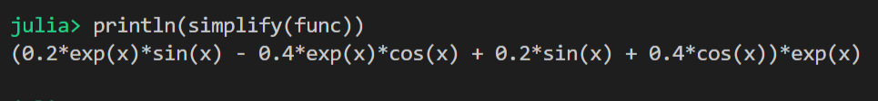
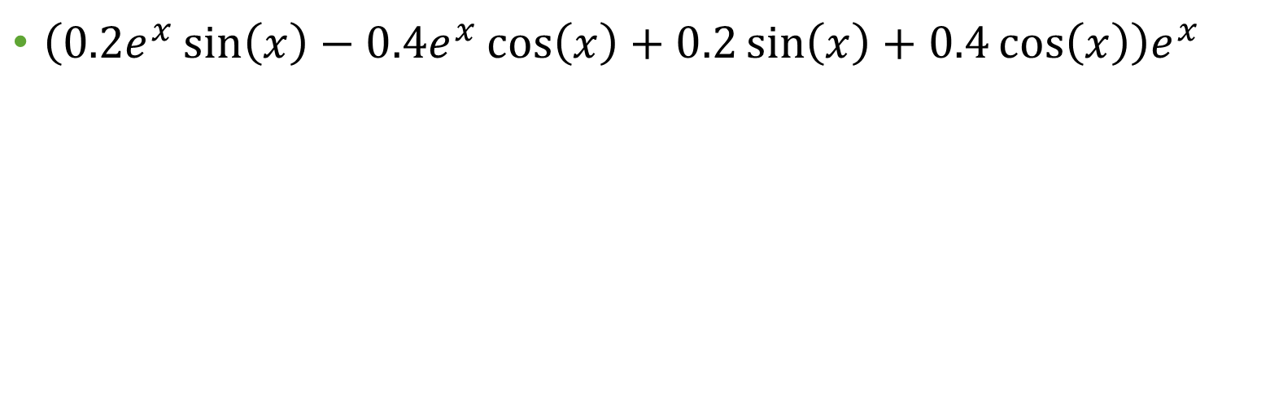
Exact solution
$\left(0.2e^{x}\sin\left(x\right)−0.4e^{x}\cos\left(x\right)+0.2\sin\left(x\right)+0.4\cos\left(x\right)\right)e^{x}$

Slide 6
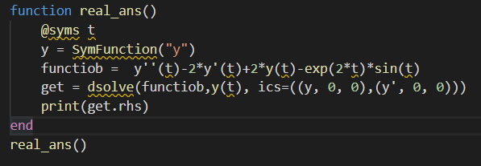

Slide 7
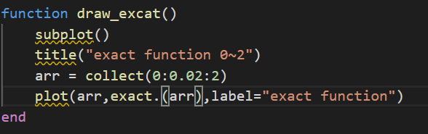
Drawing the exact solution

Slide 8
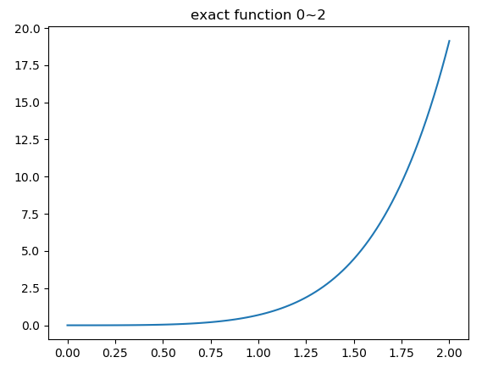
0~2 exact solution

Slide 9
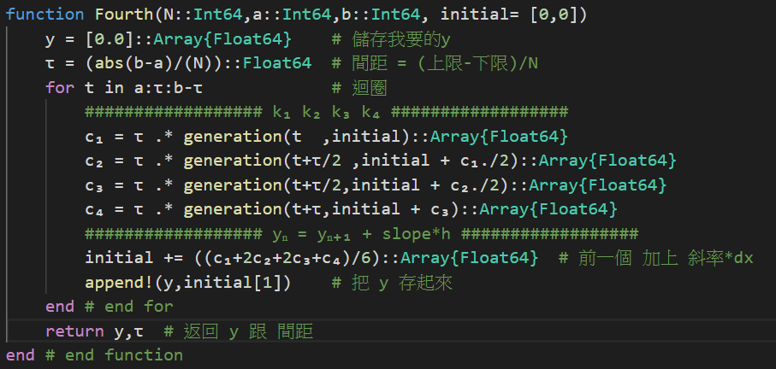

Slide 10
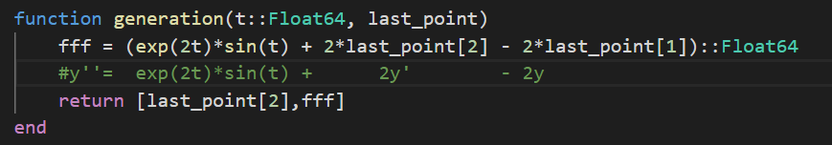
generation

Slide 11
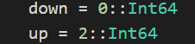
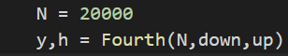

Slide 12
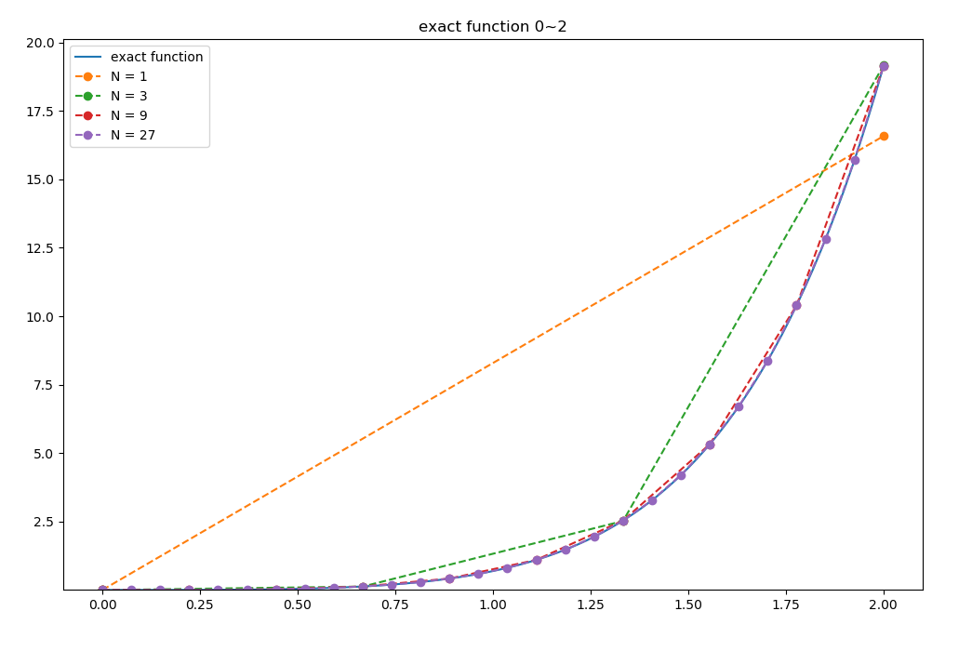

Slide 13

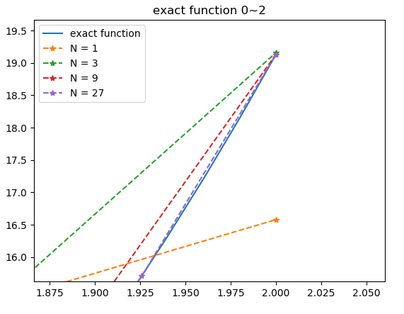

Slide 14
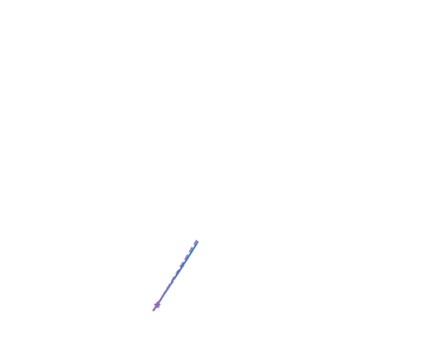
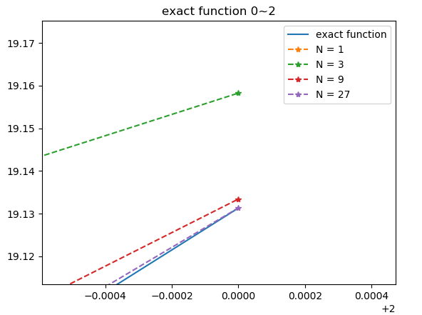

Slide 15
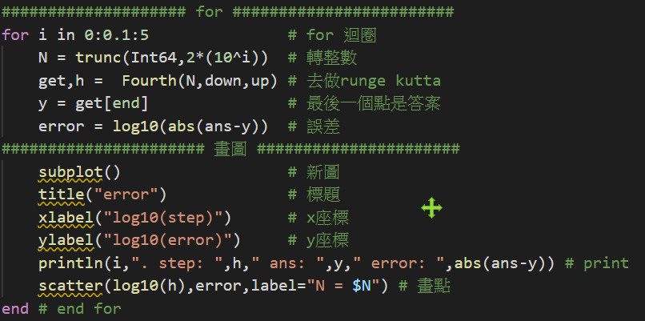

Slide 16


Slide 17
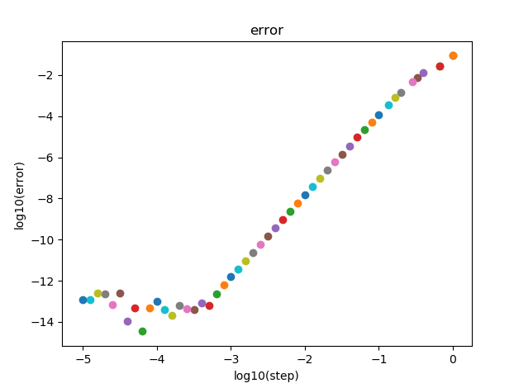
h vs error

Slide 18
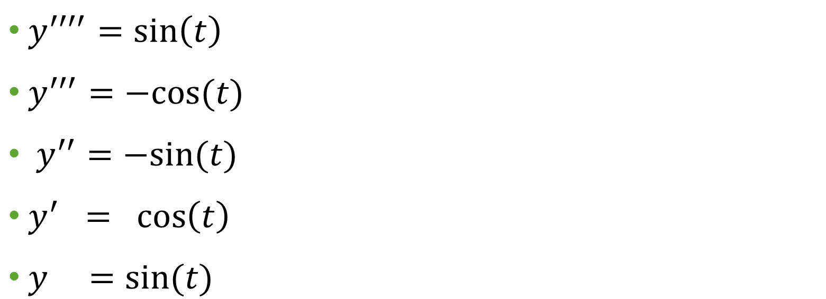
testing
$y^{′′′′}=sin\left(t\right)$
$y^{′′′}=−cos⁡(t)$
$y^{′′}=−sin⁡(t)$
$y^{′} = \cos\left(t\right)$
$y =sin⁡(t)$

Slide 19
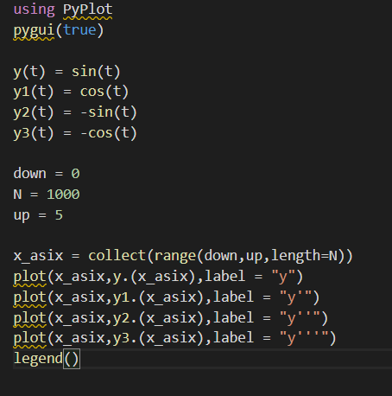

Slide 20
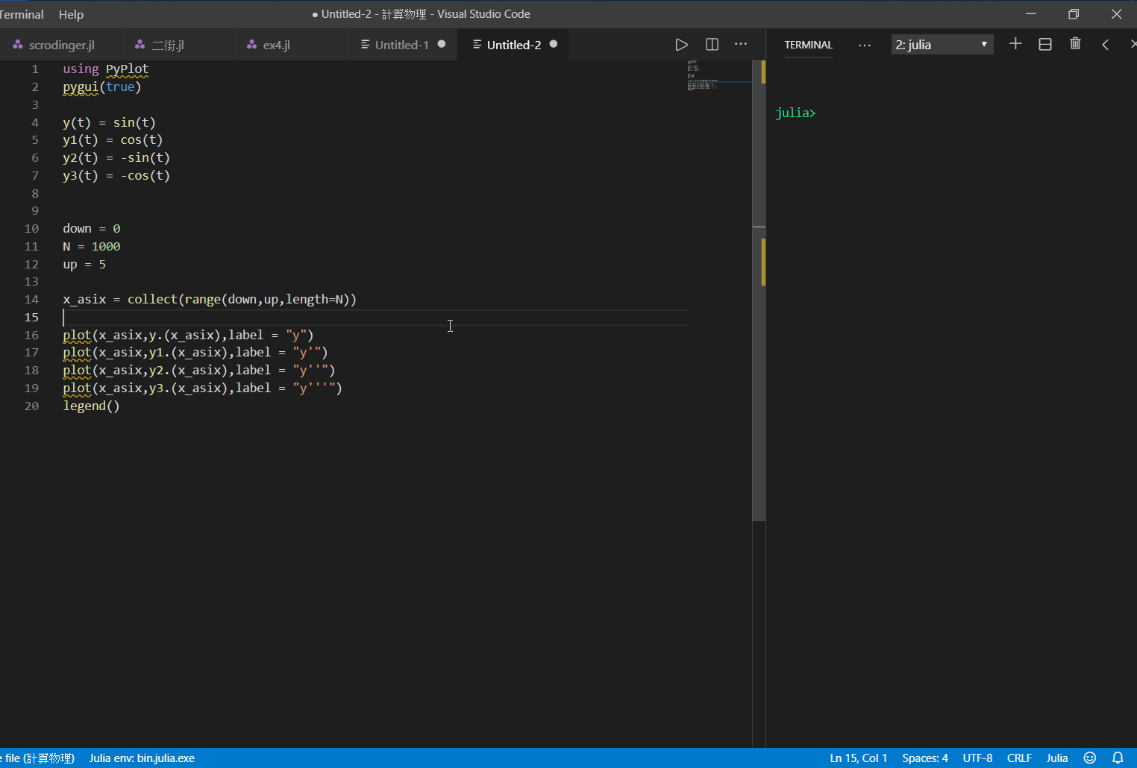

Slide 21
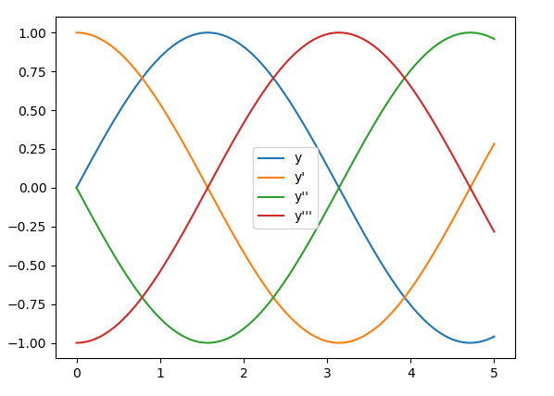

Slide 22
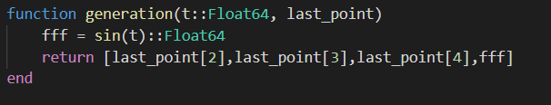
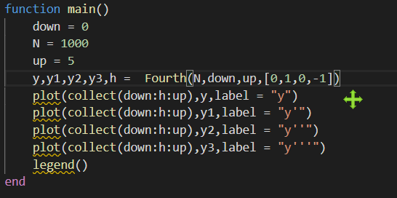

Slide 23
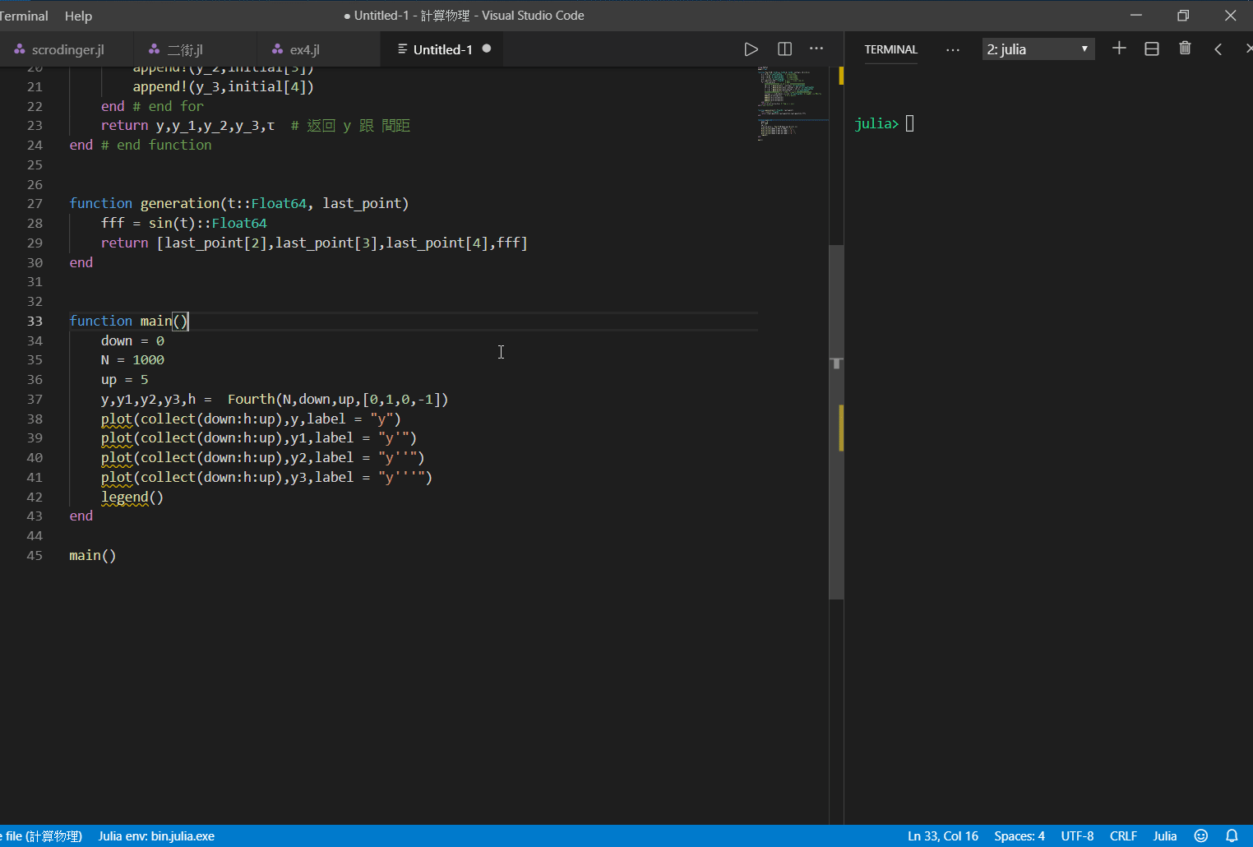

Slide 24
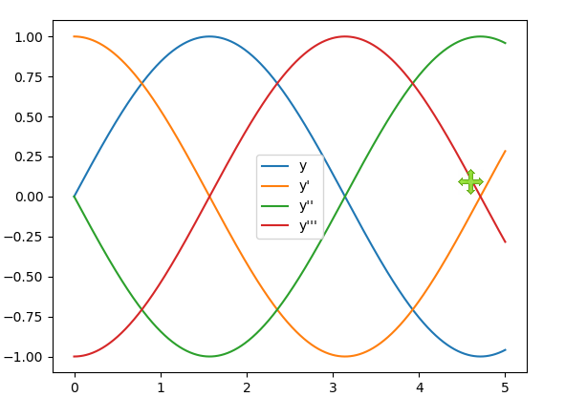

Slide 25
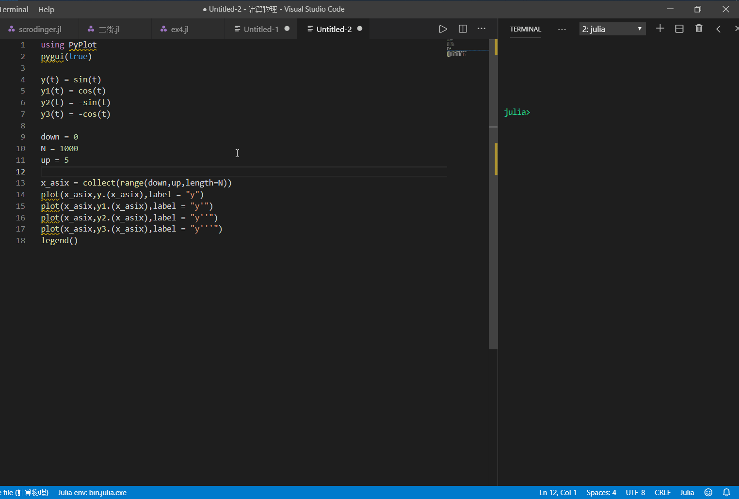

Slide 26
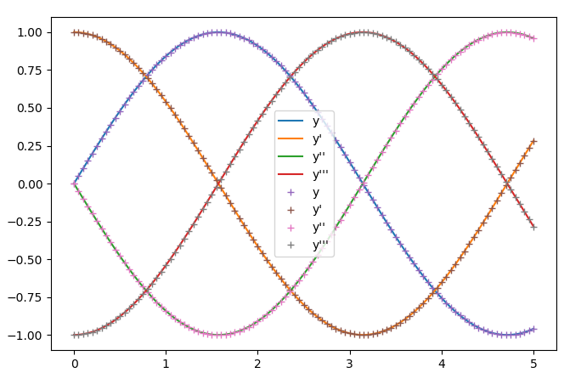

Slide 27
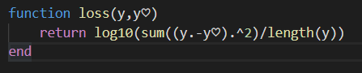
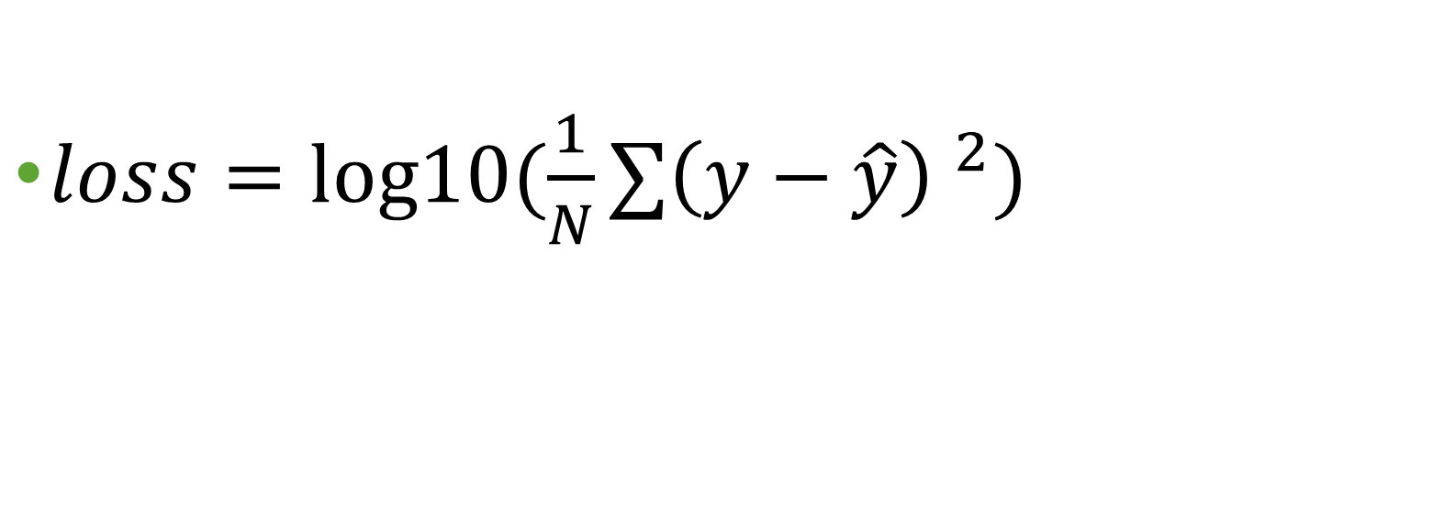
Error function
$loss=log10⁡(\frac{1}{N}∑{\left(y−\hat{y}\right) }^{2})$

Slide 28
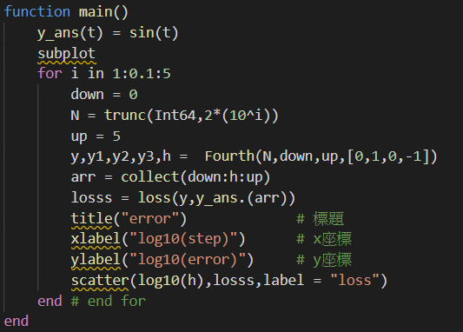

Slide 29
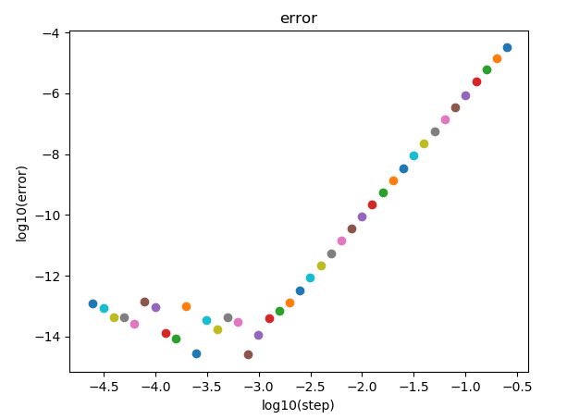
error

Slide 30

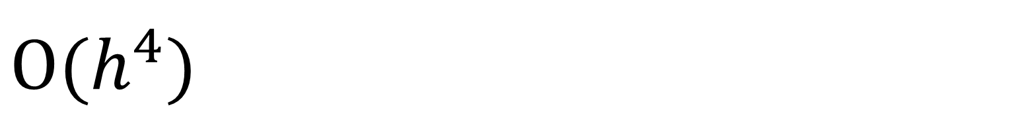

$$O(h^{4})$$
$$\frac{14−2}{3−0}=4$$
$$\frac{14−4}{3−0.5}=4$$

